Slide 1
Capital Markets
Brad DeLong
U.C. Berkeley
Last Edited: 2020-03-17
(Edited from an original created by Barry Eichengreen)
<https://www.icloud.com/keynote/0f4kHkrxIbwEGb1yge_3fKn-g>

Slide 2
Readings
Naomi Lamoreaux (1986): Banks, Kinship, and Economic Development: The New England Case <http://www.jstor.org/stable/2121478>
Lance E. Davis (1965): The Investment Market, 1870-1914: The Evolution of a National Market <http://www.jstor.org/stable/2116175>
Jeremy Edwards and Sheilagh Ogilvie (1996): Universal Banks and German Industrialization: A Reappraisal <http://onlinelibrary.wiley.com/doi/10.1111/j.1468-0289.1996.tb00576.x/abstract>
Carmen Reinhart and Kenneth Rogoff (2013): Financial and Sovereign Debt Crises: Some Lessons Learned and Those Forgotten <http://www.imf.org/external/pubs/cat/longres.aspx?sk=41173.0>
Michael Bordo and Hugh Rockoff (1996): The Gold Standard as a “Good Housekeeping Seal of Approval” <https://www.jstor.org/stable/2123971>
Warren Weber (2016): A Bitcoin Standard: Lessons from the Gold Standard <http://www.bankofcanada.ca/2016/03/staff-working-paper-2016-14/>

Slide 3
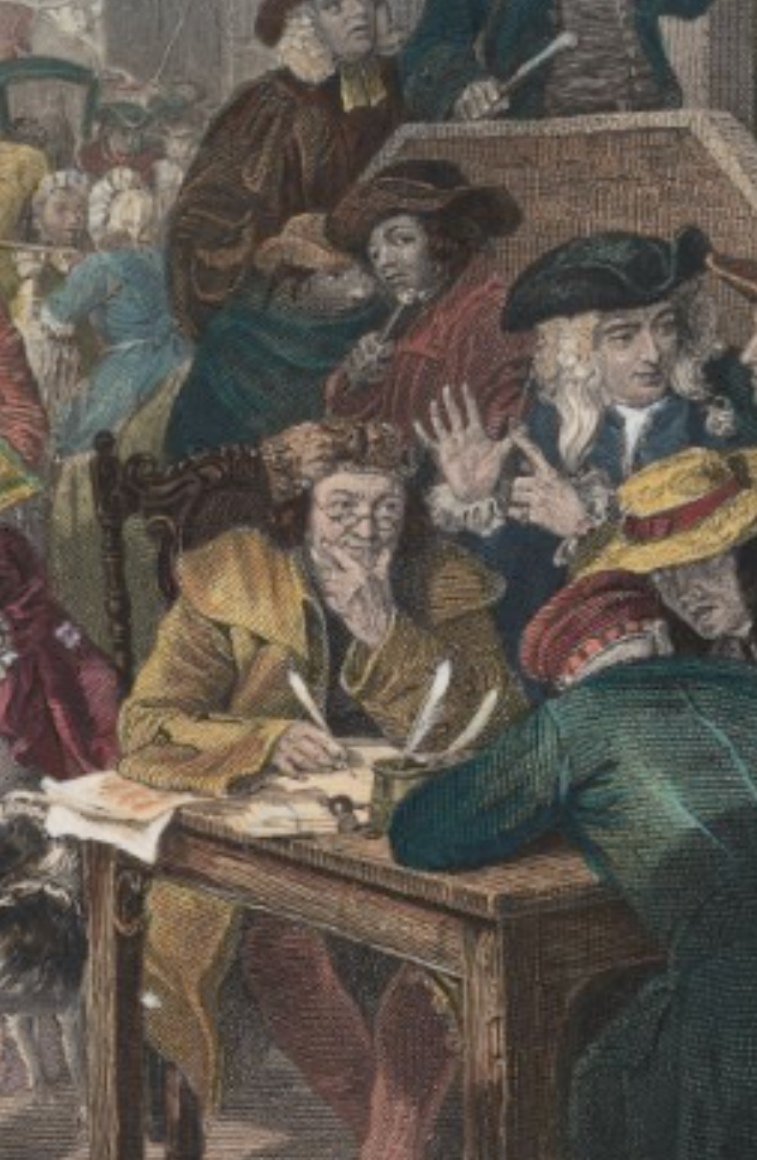
Capital Markets: Background
Incentives for Using Capital Markets:
Normally one trades generalized purchasing power (which has an exchange value) for goods or services (which have a higher use value)
Capital markets are different: there you trade money-for-money
Where, then, is the win-win here?
1:15
Notes:
Normally in a market economy it is quite clear that voluntary exchanges are win-win, and very clear why they are win-win. One party is exchanging generalized purchasing power in the form of money for a commodity that has a substantial use value, a use value larger then what they could believe they could get at the margin from holding onto their money or spending it in alternative ways. The other party has a commodity that has a very low use value for them, and would rather have generalized purchasing power. When I buy coffee from Peets both of us are happy: I get caffeinated, and that is worth much more to me than the money I have to pay; they get money, and that is worth much more to them than the marginal cup of coffee they have made. If the Peets employees drank all the coffee they made in the day, they were die: coffee is poisonous in large doses.
Capital markets are different. In capital markets people are trading money—generalized puchasing power—for money. Where, then, is the win-win here? How do these markets fit into this standard template of supply-and-demand and of producer and consumer surplus that we use to understand markets and their benefits?

Slide 4
Capital Markets: Background II
Where, then, is the win-win here?:
At different times (liquidity)
To fund immediate consumption
To fund productive investment
In different states of the world (risk, diversification, insurance)
Under different people’s control (align incentives)
Corporate governance
Monitoring borrowers (rollover and relationship)
To achieve scale:
Savings mobilization to realize increasing returns, at least over a range
Convenience (means of payment; intermediation)
3:30
Notes:
The answer to the question of "where is the win-win here?" is rather complex. There are four ways in which capital market transactions can be win-win.
First, the counterparties can be exchanging generalized purchasing power, but generalized purchasing power to be spent at different dates. One counterparty can be borrowing in order to fund immediate consumption in excess of its current resources. Thus they are happy because what they lack is generalized purchasing power now. The other counterparty, by contrast, places is a low value on the possession of generalized purchasing power now relative to the future. The win-win here is this the creation of liquidity for those who have or rather suffer from urgency and would like to scratch some particular itch right now.
Second, the counterparties can be trading generalized purchasing power in different states of the world. In some states of the world, I will be desperately anxious to have more generalized purchasing power. And in others, I will be flush and my marginal utility of wealth will be low. Capital market trades that move my wealth from states of the world in which I have a low to stay till the world in which I have a high marginal utility of wealth are enormously beneficial to me. And if I can find a counterparty whose marginal the utility of wealth gradient across different potential states of the world is different, the exchanges can be win-win. Risk management, diversification, insurance—the win-win nature of these transactions is obvious.
Third, capital market transactions can move wealth so as to place it under different peoples control. This has the powerful potential of aligning incentives: by giving one's agents a stake in the action, one can be much more sure that they will be reliable agents. Moreover, capital market transactions can serve as signals as to when principal-agent relationships are going awry: rollover requirements and relationship banking are very important ways of managing wealth, and aligning agents incentives even outside the narrow corporate governance context.
Fourth, capital market transactions can achieve some sort of scale. They can mobilize the savings of lots of individuals in order to make possible a large and highly efficient enterprise. And economies of scale can create great convenience. That's the point of means of payment and intermediation transactions–those who have an expertise in doing them cheaply should do them, and take the load off of others, in return for a fee.
Thus we have four margins along which capital market transactions can be genuinely win-win for both parties and so fit into our standard market template of supply and demand and producer and consumer surplus. But, usually, these margins are small—and this makes capital markets and their transactions fraught in the way that normal consumer markets are not.

Slide 5
Capital Markets: Background III
But what of transactions in which both parties aren’t pursuing one of those goals?:
They are behavioral cons
“Common knowledge”
The problem of volume
Jeremy Bulow:
People sitting in a circle; one person raises a hand, then puts it down
Market existence issues
John Maynard Keynes
Market functioning issues
3:00
Notes:
Liquidity, risk, incentive alignment, efficient scale—these are the four sources of genuinely win-win capital market transactions. But what if one of the counterparties in the transaction is not motivated by at least one of these four motives? And it may not be easy to find counterparties—two people whose, liquidity, risk, incentive alignment, or efficient scale motives allow the creation of a win-win capital market transaction.
So there are many capital market transactions that strike me as explicable only as behavioral cons of one sort or another. Indeed, the enormous volume of capital markets suggests that the overwhelming majority of transactions are one in which somebody is being a greater fool.
We have to start with the common knowledge problem: that rational bayesian agents should never disagree, and if you disagree with your counterparty one of the two of you is misinformed. As economist Jeremy Bulow says, economists' picture of financial markets is of a number of people sitting silently in a circle. Eventually, one of them raises her hand and starts to speak. But by so doing she reveals information. Market prices immediately move against her. So she puts her hand down. No trading takes place. The silent circle continues—but prices have moved
That is not the way the financial markets we see around us work. There are deep worries and issues about why or whether many of the markets we see do or should exist.
A classic statement of the problem of capital market functioning we owe to John Maynard Keynes's General Theory of Employment, Interest, and Money, in his chapter on "The State of Long-Term Expectation".

Slide 6
Capital Markets: Background IV
John Maynard Keynes on The State of Long-Term Expectation:
“The professional investor is forced to concern himself with the anticipation of impending changes, in the news or in the atmosphere, of the kind by which experience shows that the mass psychology of the market is most influenced.… The social object of skilled investment should be to defeat the dark forces of time and ignorance which envelop our future. The actual, private object of the most skilled investment to-day is "to beat the gun", as the Americans so well express it, to outwit the crowd, and to pass the bad, or depreciating, half-crown to the other fellow. This battle of wits to anticipate the basis of conventional valuation a few months hence, rather than the prospective yield of an investment over a long term of years, does not even require gulls amongst the public to feed the maws of the professional;—it can be played by professionals amongst themselves.... We have reached the third degree where we devote our intelligences to anticipating what average opinion expects the average opinion to be….
“If the reader interjects that there must surely be large profits to be gained from the other players in the long run by a skilled individual who, unperturbed by the prevailing pastime, continues to purchase investments on the best genuine long-term expectations he can frame, he must be answered, first of all, that there are, indeed, such serious-minded individuals…. But… several factors…. jeopardise the predominance of such individuals.… He who attempts it must surely lead much more laborious days and run greater risks than he who tries to guess better than the crowd.… There is no clear evidence from experience that the investment policy which is socially advantageous coincides with that which is most profitable. It needs more intelligence to defeat the forces of time and our ignorance of the future than to beat the gun.
“Moreover, life is not long enough;—human nature desires quick results, there is a peculiar zest in making money quickly, and remoter gains are discounted by the average man at a very high rate. The game of professional investment is intolerably boring and over-exacting to anyone who is entirely exempt from the gambling instinct; whilst he who has it must pay to this propensity the appropriate toll…”
3:00
Notes:
Here is the classic statement of the problem of capital market functioning we owe to John Maynard Keynes's General Theory of Employment, Interest, and Money, in his chapter on "The State of Long-Term Expectation":
>The professional investor is forced to concern himself with the anticipation of impending changes, in the news or in the atmosphere, of the kind by which experience shows that the mass psychology of the market is most influenced.… The social object of skilled investment should be to defeat the dark forces of time and ignorance which envelop our future. The actual, private object of the most skilled investment to-day is "to beat the gun", as the Americans so well express it, to outwit the crowd, and to pass the bad, or depreciating, half-crown to the other fellow.
>This battle of wits to anticipate the basis of conventional valuation a few months hence, rather than the prospective yield of an investment over a long term of years, does not even require gulls amongst the public to feed the maws of the professional;—it can be played by professionals amongst themselves.... We have reached the third degree where we devote our intelligences to anticipating what average opinion expects the average opinion to be….
>If the reader interjects that there must surely be large profits to be gained from the other players in the long run by a skilled individual who, unperturbed by the prevailing pastime, continues to purchase investments on the best genuine long-term expectations he can frame, he must be answered, first of all, that there are, indeed, such serious-minded individuals…. But… several factors…. jeopardise the predominance of such individuals.… He who attempts it must surely lead much more laborious days and run greater risks than he who tries to guess better than the crowd.… There is no clear evidence from experience that the investment policy which is socially advantageous coincides with that which is most profitable. It needs more intelligence to defeat the forces of time and our ignorance of the future than to beat the gun.
“Moreover, life is not long enough;—human nature desires quick results, there is a peculiar zest in making money quickly, and remoter gains are discounted by the average man at a very high rate. The game of professional investment is intolerably boring and over-exacting to anyone who is entirely exempt from the gambling instinct; whilst he who has it must pay to this propensity the appropriate toll…

Slide 7
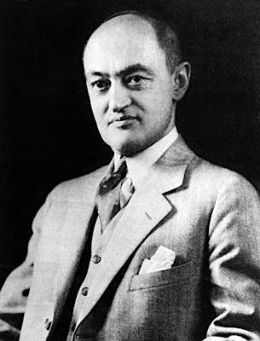
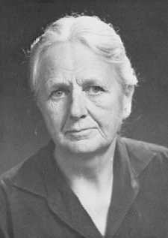
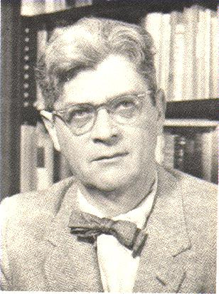
Views of Capital Markets
“11 opinions—10 from each of the other economists, & 2 from Mr. Keynes”:
Previous generations of economists:
Schumpeter: capitalism is “innovation fueled by finance”
Robinson: “finance is simply handmaiden to industry and commerce”
Alexander Gerschenkron: banks, in particular, play a key role in late-developing countries because of increasing scale with technology and the headroom for catchup
Lots of types of financial markets and institutions, working differently:
Banks
Near-banks: S&Ls, mutuals, credit unions
Markets: stock, bond, and commercial paper
Insurance companies
Investment funds
3:00

Slide 8
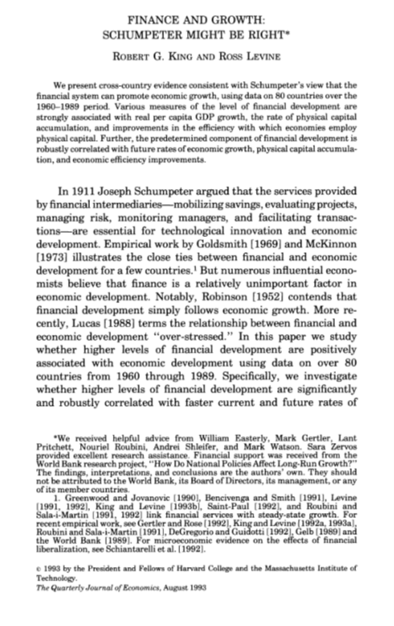
A Large Literature on These Questions…
…But it has obvious problems:
Time series reliance on lagged values of finance to “explain” growth and development
Instrumental variables that affect growth and development “only” via finance (LSV)
Diff-in-diff changes in growth trends—for example, before and after “exogenous” state-level branch deregulation
Disaggregated firm growth related to country level-financial development for different “exogenous” degree of financial dependence
Thus it may be useful to look to history…
3:00

Slide 9
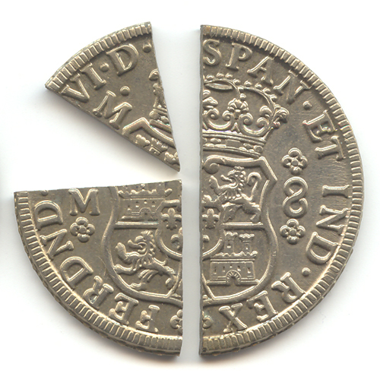
The Development of Early American Banking
Next to No Banking in the Colonial Era:
Before 1789 almost no banks in the 13 colonies.
Limited-liability partnerships had to be chartered by the British Parliament
A legacy of the Bubble Act of 1720
A very few unlimited-liability private banks, the most successful of which was established in South Carolina in 1731 and lasted for 10 years
Most credit was therefore provided by nonbank sources.
Merchants extended credit to customers.
Monetary circulation a mix of:
foreign coins (Spanish pieces of eight),
commodity currencies (tobacco warehouse receipts), and
paper obligations of colonial governments
3:00

Slide 10
Banking in the Early United States
First bank was chartered by the Continental Congress:
First bank, The Bank of North America, chartered in 1782 to operate in three states:
Re-chartered as a state bank (and renamed as the Bank of Pennsylvania) in 1787
Why? State opposition to federal charters.
Thereafter, state government chartered banks
Limited liability
Note issue up to a prescribed limit.
As of 1790, only four
1791: Hamilton’s national bank, The Bank of the United States, with a 20-year charter.
Thereafter rapid development of something resembling a banking system in New England, and then more widely: Cf. Lamoreaux
3:00

Slide 11
Naomi Lamoreaux: Banks, Kinship, and Economic Development: The New England Case
What were these early New England banks?:
Dominated by families:
Upwards of 80 per cent of loans were made to family members.
In fact, majority of loans made to bank directors
Kinship networks and social sanctions as a basis for information gathering and contract enforcement when accounting practices are unreliable and property rights are insecure
Not deposits: capital and note issue
New England, families initially pooled their resources in order to fund shipping enterprises:
Banks then formed to disburse funds from this pool to other family members needed loans for working capital etc.
Move from funding shipping to funding merchants and factory builders
3:00

Slide 12
To What Extent Did These Early Banks Work?
What do we think of Lamoreaux’s story?
Could the failure to mobilize the savings of the public through deposits have been a source of capital constraints?
Did bankers really fail to raise deposits because they “weren’t interested,” as Lamoreaux suggests?
Or was it perhaps that outsiders were reluctant to commit funds to banks that favored family members?
Weren’t these banks too small, as a result of their inability to raise deposits, to adequately fund modern industrial enterprises?
Lamoreaux notes that outsiders, even when their credit was good, were often denied loans owing to banks’ “lack of funds.”
So maybe these banks in fact did a poor job of mobilizing the resources of small savers and intermediating them in modern fashion.
Possibility of cronyism, in that loans not only went to insiders but also, not infrequently, were not repaid.
Bank-corporate connections (insider lending) is widely criticized in other contexts (Asian crisis of 1997-8, Subprime crisis).
3:00

Slide 13
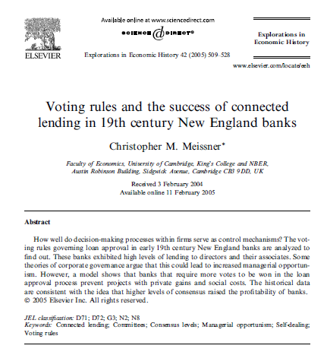
Controlling Cronyism
Chris Meissner:
Were there governance mechanisms to deal with problematic aspects of insider lending?
Barry Eichengreen asked and Chris Meissner answered this question:
Banks established loan committees
Banks with larger, more encompassing loan committees had better outcomes
Meissner relates loan committee size and structure to bank profitability (as measured by the stock price). He finds a positive relationship even after controlling for other bank characteristics (age, scale)
Begs the question of what explains the establishment, size, diversity, and choice of voting rule on the loan committee
But this is progress
3:00

Slide 14
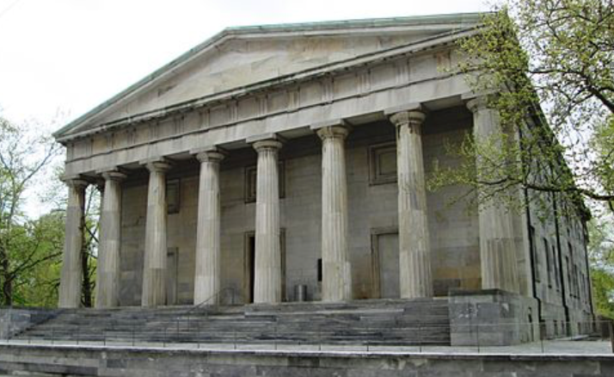
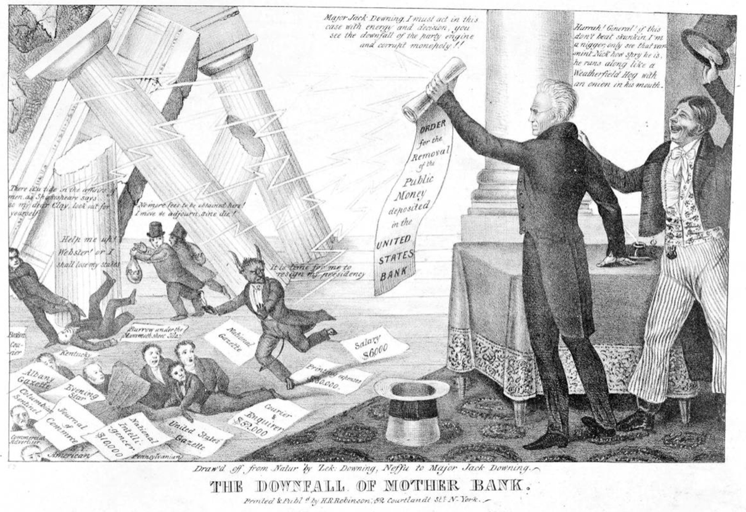
Further American Institutional Developments Up to the Civil War
Chris Meissner:
James Madison’s view
McCulloch vs. Maryland
The Bank of the United States
Banked for the federal government:
Only bank operating in many states
Only bank with a quasi-national branch network.
Andrew Jackson saw it as “Big Government”:
He vetoed its recharter when this came up in 1832
Like Thomas Jefferson before him
Needed: institutional/legal innovation to fill a supply-of-intermediation-services gap
3:00

Slide 15
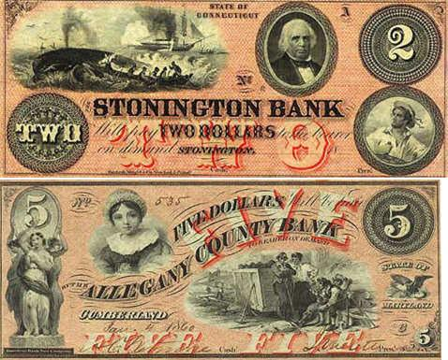
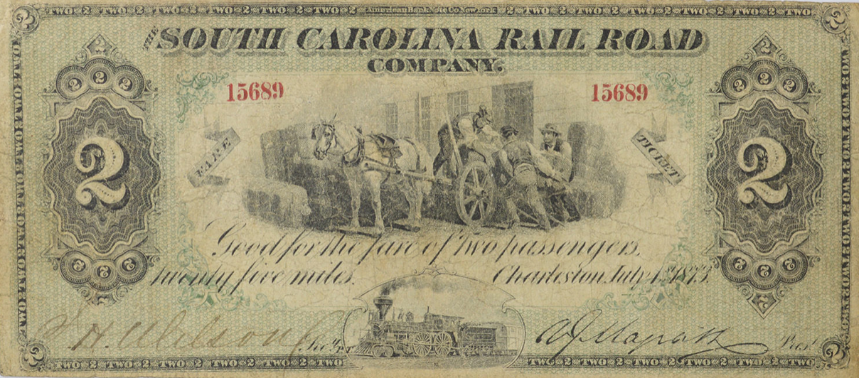
Institutions Respond
Expanded system of state charters from the 1830s:
New banks funded by shareholders, by (some) deposits, and by note issues
Banknotes circulated as money
When the bank made a loan it paid out the funds it was loaning in engraved notes
Banks were required to redeem their notes for specie upon demand, in full.
Banks did not always do so…
Charter requirement a mechanism for corruption, favoring insiders)?
Those few banks possessing charters enjoyed monopoly power?.
One source of market discipline, the Bank of the United States, then disappeared in 1836.
3:00

Slide 16
“Free Banking”
In about half the states, Free entry and competition as “market discipline”:
If you had:
a minimum amount of capital
redeemed your notes at par with specie
held specie, or
deposited specie or railroad or state government bonds with the state banking authority.
Entry was free—but banks were still regulated
3:00

Slide 17
Moral Hazard and “Wildcat Banking”
Bank cashier retires to “where the wildcats roam”:
After taking advantage of a wedge between the face and market values of securities:
Minnesota: Use 5000 to purchase railway bonds with a face value of 100,000
Deposit these with the state banking authority
Loan yourself 95,000 of banknotes (95% of face value)
Use those notes to buy goods, services and assets from counterparties
.Then:
State declares bank insolvent
Noteholders would get whatever they could from the collaterala minimum amount of capital
3:00

Slide 18
The Indictment of Free Banking
The potential for moral hazard gums up the market:
Reluctance to accept bank notes
Absence of a uniform currency
Distrust pervasive: 86 per cent of all free banks in Indiana ultimately failed
Many just in the business of issuing notes enrich their founders
The United States lacked an efficient banking system an expanding economy needed
Revisionism!:
.Hugh Rockoff: “The Free Banking Era: A Reexamination”: many free banks in fact paid their obligations in full: New York vs. Minnesota:
Banknote reporting services: made it hard for banks that didn’t hold adequate collateral to get full value for their notes, which reduced the incentive to wildcat
Rockoff: loss of wealth to noteholders in free banking states over the 1836-60 period was only $2 million (US GDP in 1860 was $5 billion)
3:00

Slide 19
Time vs Sample Averages
If so many banks failed, how could depositor losses have been so limited?:
An analogy:
In societies with high infant mortality rates
The life expectancy of the average adult is relatively long
Most “life experience” is that of long-lived individuals.
Many banks were entering and exiting
Most bank experience was with long-lived institutions
3:00

Slide 20
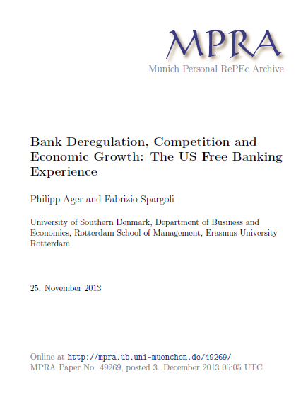
So How Important Was “Free Banking”?
Ager & Spargoli:
Traditional vs. revisionists tells us little about the efficiency effects and impact of free banking.
So how might you go about “testing for” efficiency?
You might attempt to exploit the fact that not all states adopted free banking laws.
You might then attempt to test whether industry (or specifically industries more reliant on external finance grew faster in free banking) states
3:00

Slide 21
Obvious Problems with Their Findings
They found that free banking had a surprisingly large depression effect:
But obvious problems:
Small number of observations
Not everything else was equal (or observable)
The adoption of free banking was not random
3:00

Slide 22
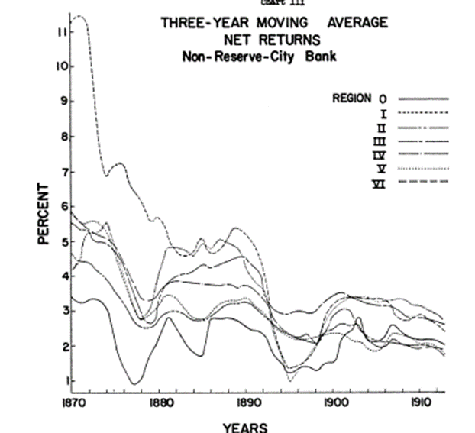
You Might Use Regional Integration as a Measure of Market Efficiency
Lance Davis’s Classic Article:
Especially appropriate for the 19th century United States
Computing interest rate differentials across space
Commercial paper was the preferred instrument for shifting funds across regions and creating a national capital market
Capital markets were not well integrated
But they then became progressively better stitched together
Although the South remained notably less integrated
3:00

Slide 23
Problems with Davis
Raw interest rates need to be adjusted:
For risk: Barry Eichengreen, “Mortgage Interest Rates in the Populist Era”; Howard Bodenhorn, “A More Perfect Union: Regional Interest Rate Differentials in the United States”)
For regulatory barriers to entry resulting in market power: Richard Sylla, “Federal Policy, Banking Market Structure and Capital Mobilization in the United States, 1863-1913”
3:00

Slide 24
Regulation Especially
The Civil War-Era National Banking Act:
A uniform national currency issued by national banks and backed by federal government bonds.
A captive market for those federal government bonds.
National banks (now receiving a federal charter) were required to hold them. A third of their capital had to be in government bonds. In return, banks received national bank notes in the amount of 90 per cent of the value of the bonds
High capital requirements for national banks
State chartering was still possible, but notes issued by state banks were taxed, initially at a 2 percent and then at 10 percent
3:00

Slide 25
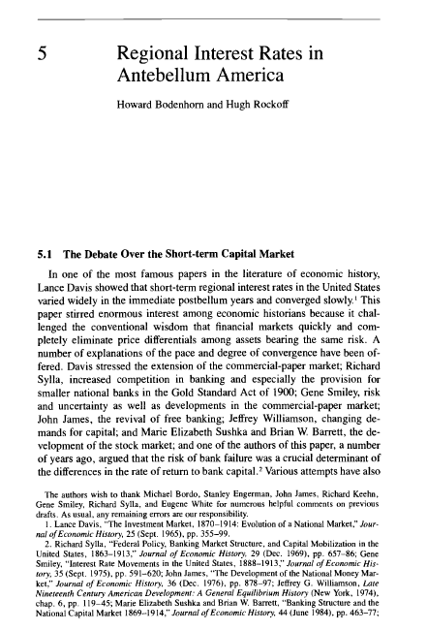
What Would We Expect to See?
If Sylla were right, and regulation was important?:
We would expect smaller interest differentials before 1864, when the new higher capital requirements of the National Banking Act were adopted.
Constructing regional interest rate data for this earlier period is harder, since you have to go back to state banking reports, which are not uniform and standardized. But it is not impossible.
And this, in fact, is what Bodenhorn and Rockoff subsequently found
3:00

Slide 26
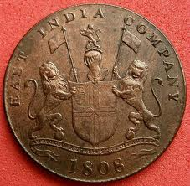
Securities Markets?
In this era, mainly not:
Information and agency problems facing outsiders were severe
Only a handful of joint stock companies—notably the Dutch and English East India Companies – succeeded in issuing shares.
What prevented insiders from expropriating outsiders? Agency problems were held in check by the fact that the goods could be observed when the ship docked on returning from the East Indies
The Dutch Company was organized on a permanent basis in 1612. The Dutch Government granted the company articles of incorporation. The Company agreed to provide the government with regular accounting
Permanent incorporation was reconciled with investors’ liquidity needs by allowing shareholders to trade shares in coffee houses and, eventually, on exchanges
3:00

Slide 27
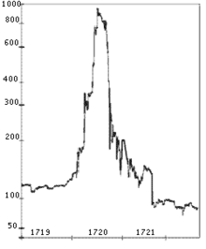
The South Sea Bubble
The English experimented—unhappily—with the corporate form in finance in the 1710s:
Incorporating their East India Company 1717 (but without that special accounting and government oversight)
Other trading companies followed
Notably the South Sea Company
The South Sea Bubble (shares of the South Sea Company) in 1720 (shown at right)
Leading to the Bubble Act, which banned the formation of joint stock companies, except on granting of a royal charter
Again, suppressing the role of stock markets
3:00

Slide 28
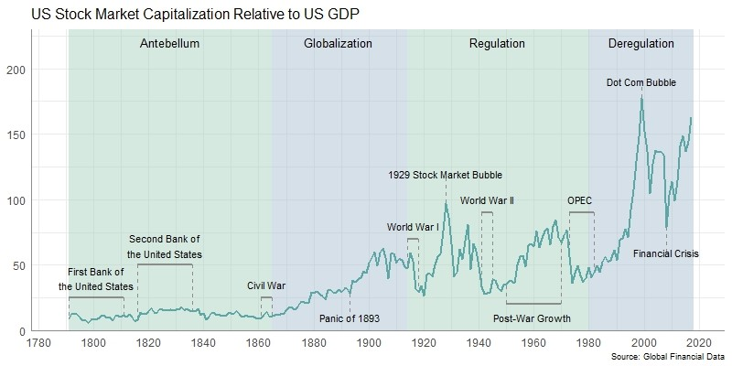
The End of the Bubble Act
Bubble Act repealed in 1825:
In response to the need for more finance, or maybe because memories of the South Sea Bubble had faded.
Stock markets then developed slowly over the course of the 19th century.
But stock market capitalization remained limited (few nonfinancial corporations were able to issue shares).
Mainly canal and railways, which had government sponsorship and tangible assets, making them relatively easy to monitor.
Otherwise, equity stakes were held by insiders (partners), reflecting those same information and agency problems and high fixed costs of overcoming them.
In the US, Pullman was essentially the only industrial corporation whose stock was actively traded on the NYSE prior to 1890 (maybe because of its association with the railways).
3:00

Slide 29
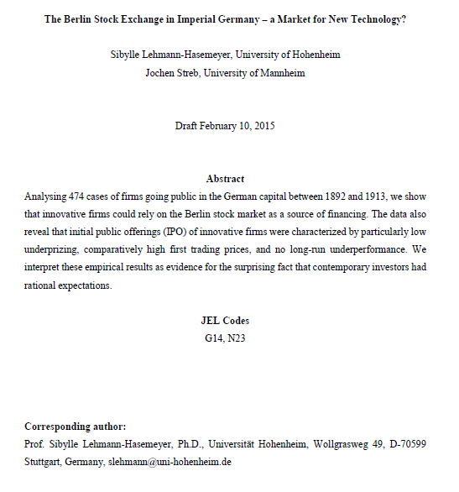
Floating Bonds and Shares
We see companies in industries other than RR starting to float shares at the end of the 19th century:
As a result, it is said of institutional innovation: universal banks enter the stock underwriting business.
(They advance money to the firm (after taking their commission), market the security at an IPO price, and use their reputations to credibly signal that the start-up is reputable (as these authors purport to show).
(Is Edwards and Ogilvie compatible with this?)
We see similar developments in the US, where investment banks play the underwriting role of universal banks
3:00

Slide 30
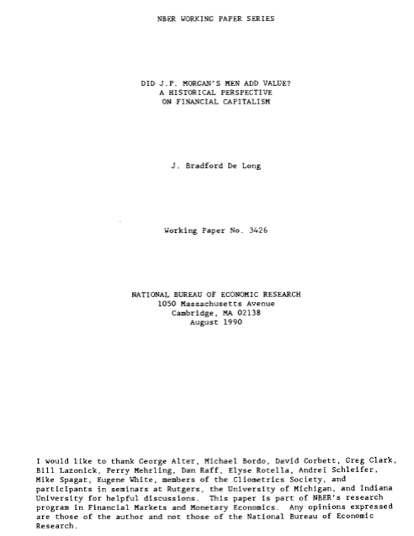
Floating Bonds and Shares
Stock markets appropriate for environments of high technological uncertainty:
So investors can take bets on competing technologies
This assumes that IPO underpricing (resulting from the fact that investors can’t tell which new technology and firm are viable, or which management team is competent and honest) is not too severe (IPO underpricing discouraging management from going public).
Where investment banks, by screening IPO candidates and signaling the results by serving on boards of directors, limit the extent of underpricing which would otherwise preclude new issuance
Debt securities were safer (they were senior —you got paid first, so you had to worry less about what went on inside the firm).
The need to roll over short-term debt was a check on management self-dealing—it was a disciplining device on practices that would have otherwise deterred external finance.
Significant information asymmetries, which even seniority and short-term issuance were not sufficient to overcome.
3:00

Slide 31
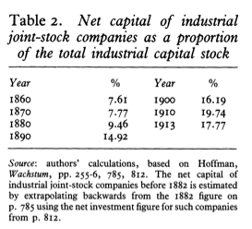
Revisionism from Edwards and Ogilvie
Did universal banks played a major role in financing German industrial investment and thus spurring economic growth?:
“Even in 1913… 8o per cent of the industrial capital stock was accounted for by firms which were not joint-stock companies
Unless the linkages from these companies to the rest of the industrial sector were extraordinarily important for German industrialization, these empirical findings refute the claim that such companies, and through them the universal banks, were crucial for industrializatio
The period i895-I9I4 saw industrial companies making greater use of external finance:
Partly because of relatively rapid economic growth,
Partly because mergers increased industrial concentration.
Both factors increased the profitability of investment, making industrial companies more willing to use external funds
This did not increase banks' ability to influence industrial companies
The high profitability of German industrial companies in this period created enormous competition among banks for firms' financial business
3:00

Slide 32
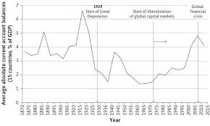
International Finance
Which seems surprising, given the highly imperfect information environment.
The Latin American republics (and others) were newly independent and unfamiliar to many investors.
Information about their economic, financial and political situation was incomplete.
This created cope for adverse selection and moral hazard.
One would imagine a market-for-lemons problem.
One would imagine scope for fraud, in other words.
And yet large amounts of lending and borrowing did in fact occur and yield respectable rates of return.

Slide 33
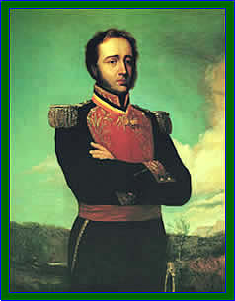
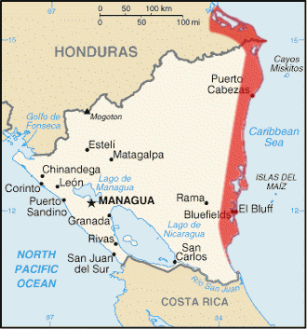
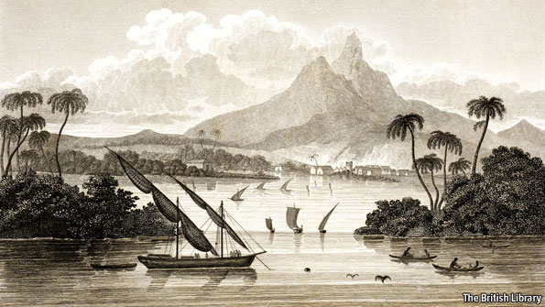
The Cazique of Poyais

Slide 34

Reputation and Brand Names
Say the Government of Argentina wanted to borrow…
It contacted an underwriting bank, typically in London.
Like Baring Brothers, at right; or a bank in Paris, Berlin, Amsterdam, or Hamburg.
Barings had knowledge of the market, could sound out investors, could recommend the bonds to investors using its good name.
Barings then advanced funds to the borrowing government.
It marketed the bonds by taking out a “tombstone” in the newspaper, where it advertised its involvement.
It took as a commission the difference between the receipts on the bond sales and what it had advanced the government.
It could act as agent, collecting the coupons and paying out interest to the bondholders.

Slide 35
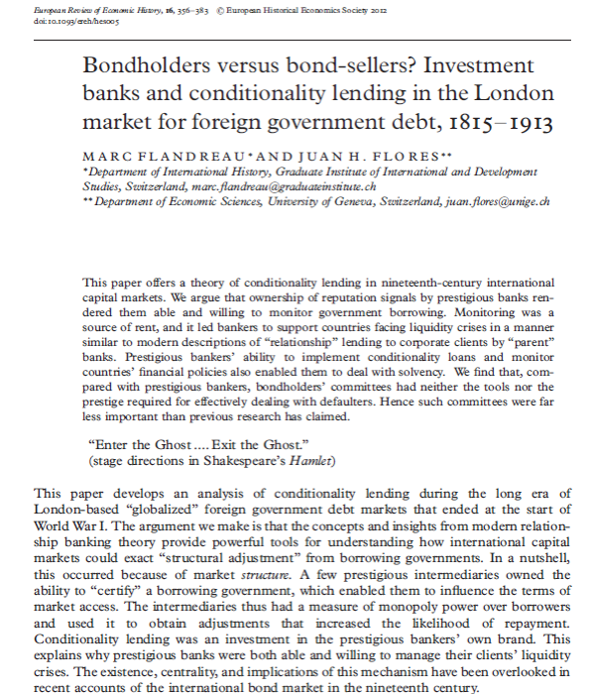
Reputational Equilibrium Are Not Always Sustainable
To sustain it, a firm needs to:
Intend to be long-term greedy
Actually be long-term greedy
Be perceived to be long-term greedy
This is going to be mostly lecture today…
New entrants and fly-by-night operators may be tempted to use whatever reputability they have to maximize short-term profits at the expense of investors.
There were relatively few defaults on bonds underwritten by Rothschild’s and Baring’s, the reputable “names,” but many defaults on bonds sponsored by new underwriters.
Borrowers could threaten to defect from their long-standing underwriter to a new entrant. When they did, the long-standing underwriter might give its endorsement to a subprime issue at risk to its good name, simply to retain the business. (Sounds like shopping for credit ratings…)

Slide 36
Finance, Trade, Growth, and Default
Complementarities Between Trade and Investment:
More exports allowed debts to be serviced and encouraged borrowers to stay on good terms with their creditors. In effect, capital exports were part of a larger international system.
Between 1870 and1913 world trade as a share of production increased from less than 6% to more than 9%.
In particular, Britain, the main lender, maintained an open market for exports of the countries to which it lent.
Story was very different in the 1930s, as we will see in a couple of weeks.
But how do we know what caused what? We will want to return to this.

Slide 37
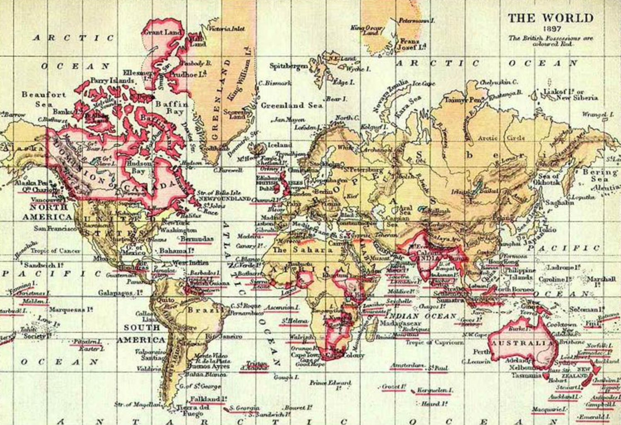
Complementarities Between Capital and Labor Flows
You could migrate to the Western Hemisphere without a visa or even need for a passport (if you were European).
Michael Clemens & Jeffrey Williamson, “Wealth Bias in the First Global Capital Market Boom, 1870-1913,” Economic Journal (2004). Suggest that “capital chased labor.”
Both migrated to overseas regions of recent settlement, attracted by an abundant, cheap third factor. (Although one can question whether they successfully identify what “chased” what…)
Rui Esteves and David Khoudour-Casteras, “Remittances, Capital Flows and Financial Development During the Mass Migration Period,” European Review of Economic History (2011). But it now looks more like ”labor chased capital”

Slide 38
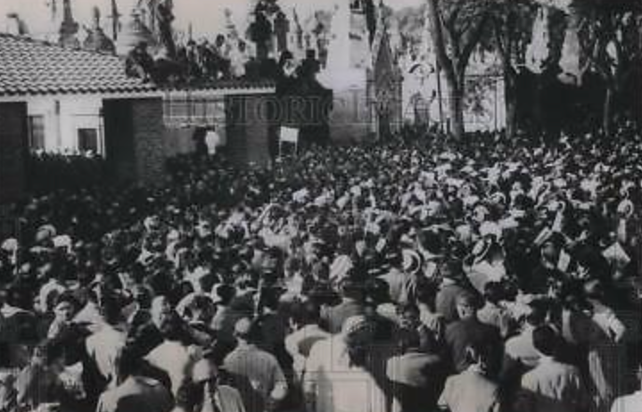
Complementarities Between Lending and Political Conditions
The British Commonwealth and Empire, within which much of this capital flowed, was a political bloc as well as an economic bloc (not exactly apolitical).
Colonial administrators were under instructions to repay what had been borrowed.
Common legal framework.
Autonomous members of the Commonwealth shared an identity with the lenders (you don’t normally default on a loan from your own family).
As a result, it appears, spreads within the Commonwealth and Empire were about 100 basis points lower than otherwise. See: Niall Ferguson and Moritz Schularick: “The Empire Effect: Determinants of Country Risk in the First Age of Globalization, 1880-1913,” Journal of Economic History (2006).

Slide 39

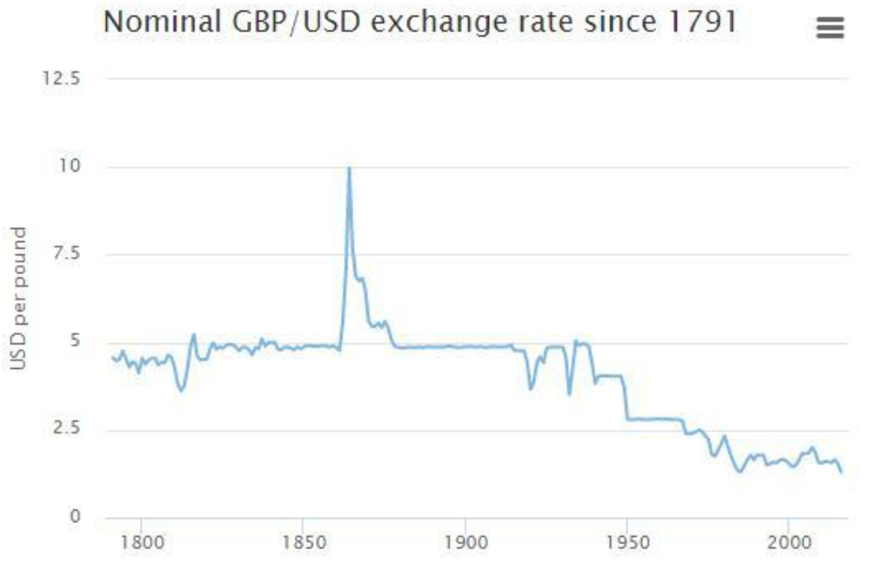
Complementarities Between the Monetary and Financial Frameworks
That monetary framework seemed to be able to accommodate relatively large capital inflows and outflows much better than a modern fixed exchange rate system.
Michael Bordo and Hugh Rockoff, “The Gold Standard as a Good Housekeeping Seal of Approval,” Journal of Economic History (1996).
We will talk about this next week…

Slide 40
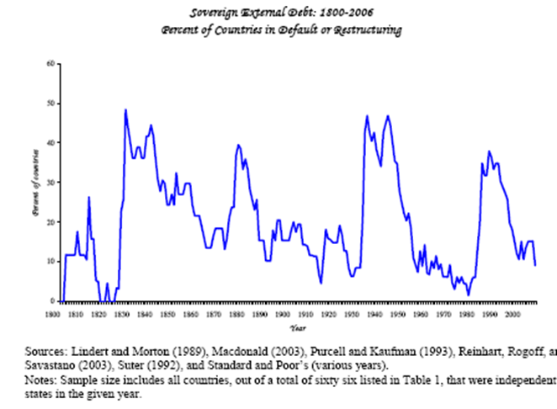

All This Gives the Impression of a Smooth Process of Capital Transfer
But the process was not always smooth.
Defaults were not uncommon.
Same countries (so-called “serial defaulters”) were implicated repeatedly (among them Argentina, Peru, Mexico, Turkey, Egypt, Russia and Greece).
Raising implicitly the question of why the lenders continued to lend to the usual suspects.

Slide 41
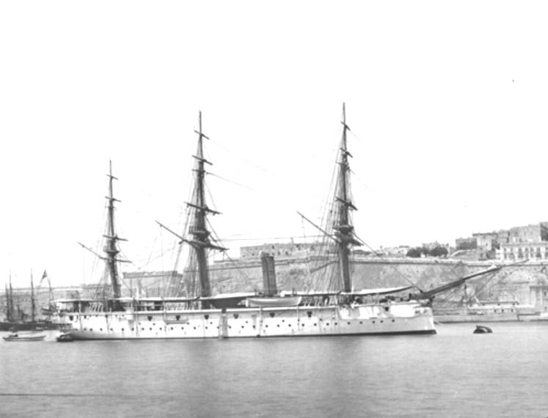
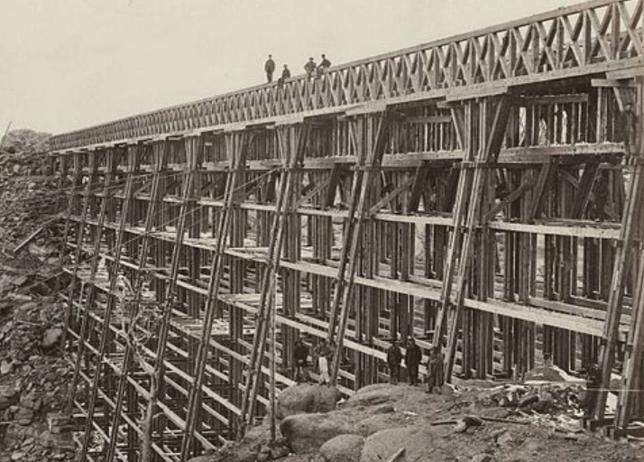
So What Was a Bondholder to Do?
In the late 19th century, legal recourse was nonexistent.
Sovereign immunity was even more absolute than today.
Gunboat diplomacy, which much remarked on, was exceptional.
To be sure, the British intervened in Egypt; the US in Cuba, Honduras and the Dominican Republic.
But in many cases debt default was simply a pretext for intervention, motivated by security concerns, that was wanted on other grounds.
In other words, the bondholders could not depend on it.
Lenders’ main recourse was to attempt to bar borrowers from the capital market until an acceptable restructuring was negotiated.

Slide 42
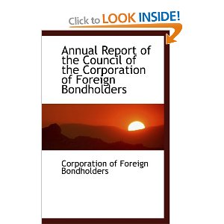
Was an Approach Based On Capital Market Sanctions Effective? What Made It So?
Bondholders organized themselves. Rui Esteves, “The Institutional Foundations of the International Capital Market Before 1914,” Journal of Economic History (2008).
Establishing representative committees
CFR, at right, was wound up in 1988 (now that the era of bond finance was over…!)
Governments of creditor countries supported the creation of these organizations
Committees worked closely with the stock exchange
Competing/fly-by-night committees were a problem; official charters were the solution

Slide 43

Outcome
35 per cent write-down rate when things went wrong seems to be an historical regularity. Barry Eichengreen and Carolyn Werley, “How the Bondholders Fared,” in James Foreman-Peck, The Globalization of the World Economy: Historical Foundations of Globalization (1998)
Lenders demanded an ex ante premium, or additional return (8% interest rather than 4-5%). This premium more than compensated them for when things went badly. Josefin Meyer, Carmen Reinhart and Christoph Trebesch, “Sovereign Bonds since Waterloo,” NBER WP 25543 (Feb. 2019)
This explains why lenders were willing to “keep making the same mistake” (it wasn’t entirely a mistake…)

Slide 44
Under What Conditions Were Serial Defaulters Able to Borrow Again?
First, they had to conclude a mutually acceptable restructuring.
Then they had to put in place credible fiscal reforms.
The gold standard may have been important here as a signal and a constraint on policy. (as Bordo and Rockoff argue*). Michael Bordo and Hugh Rockoff, “The Gold Standard as a Good Housekeeping Seal of Approval,” Journal of Economic History (1996)
Pointing to the role of the international monetary framework, to which we will return…

Slide 45
Catch Our Breath…
Ask a couple of questions?
Make a couple of comments?
Any more readings to recommend?
<https://www.icloud.com/keynote/0f4kHkrxIbwEGb1yge_3fKn-g>

Slide 46
Organization: Capital Markets
Capital Markets: Background
Market structure
Previous economists’ views
Early American Banking
Colonial and federal eras
Early national banking
After the Civil War
The Emergence of Securities Markets
The South Sea Bubble and afterwards
Investment banking
International Finance
Finance, Trade, Growth, and Default
Complementarities
Default

